Slide 1








Spreadsheet Final Presentation
Lin Shuyan
Kenneth Low Yan Wei
Peace Tay Jiunn Ching
Widya Tantiya Yutika
Yap Pin Yaw
Singapore’s water needs

Slide 2
By 2061, imported water is no more
Desalination
Local catchment
Newater
Imported water
Process of converting sea water into fresh water
Collect rainwater and process into fresh water
Purchase raw water from Malaysia, Johore
Recycle waste water into fresh water
Potable water
Non-potable water
Also known as drinking water
Supplied to households (“Domestic”)
And offices/shopping malls etc (“Non-domestic”)
Used for industry, factories, construction
Supplied to factories for washing, irrigation etc
Can be mixed with raw water and processed to become drinkable

Slide 3
Government 2060 Target
Water
Potable
Non-Potable
Domestic
Non-Domestic
Industrial
NEWater
^30%
*70%
^30% of Singapore’s total water needs in 2060
*Government’s projections based on economic growth

Slide 4
Assumptions
Infrastructure
Environmental
People
Capacity of future and new water plants is the average of 3 newest existing plants
Singapore will always have 2 months worth of potable water reserve stored
70 percent water loss via surface evaporation
10 percent water loss via seepage underground
Government’s water conservation target of daily 130 liter per capita by 2030 is met
Population, and economy continues to grow until 2060

Slide 5
Analysis Approach
Low water demands | Expected water demand | High water demands
Low population projection | Expected population projection | High population projection
High rainfall | Expected rainfall | Low rainfall
High Conservation Effort | Expected Conservation Effort | Low Conservation Effort
High water price | Expected water price | Low water price
What is the water supply needed?

Slide 6
Computation
Variables | Method
Population projection | Base population * Birth rate * Death Rate + Net migration
Local catchment | Land area * Rainfall
Water price curve | Demand sensitivity of 0.4 [Based on literature]
Conservation efforts | Linear decrease [Government target]
Portable Water Reserve | Current Supply – Current Demand = 2 months Supply
Demonstration of model
Excel demo

Slide 7
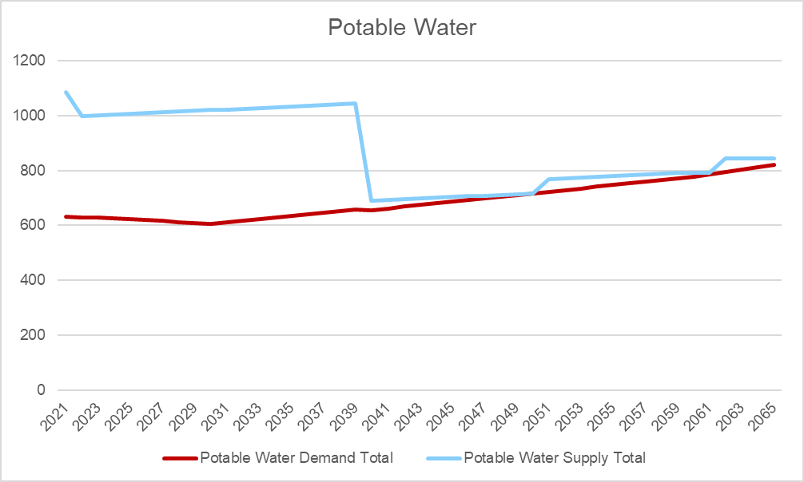
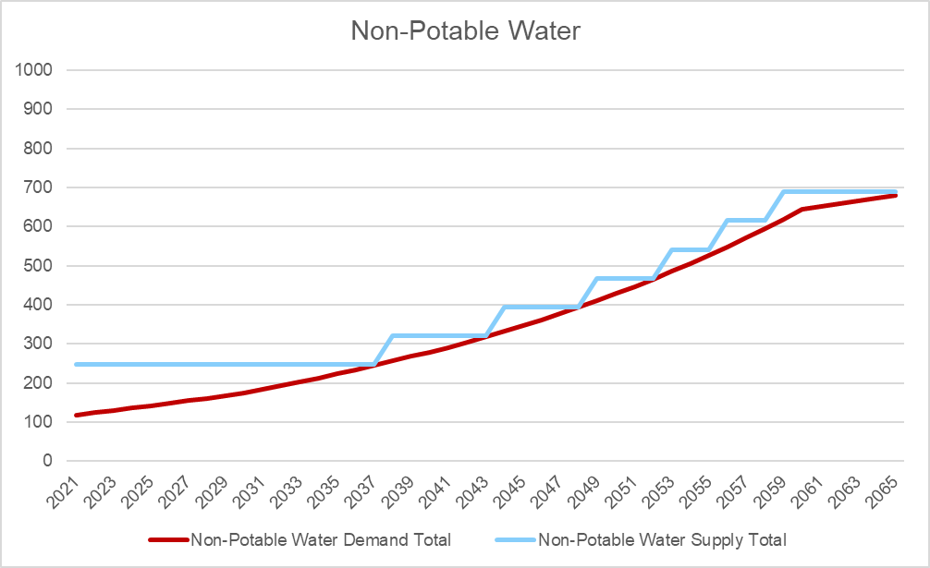
Scenario 1 - Expected water demands
Expected water demands
Medium population projection
Medium rainfall
Expected Conservation Efforts
Medium water price hike
Agreement ends in 2040
# New Build Desalination Plant | 3
# Plants | Required by
1 | Year 2040
2 | Year 2051
3 | Year 2062
# New Build NEWater Plant | 6
# Plants | Required by
1 | Year 2038
2 | Year 2044
3 | Year 2049
4 | Year 2053
5 | Year 2056
6 | Year 2059

Slide 8
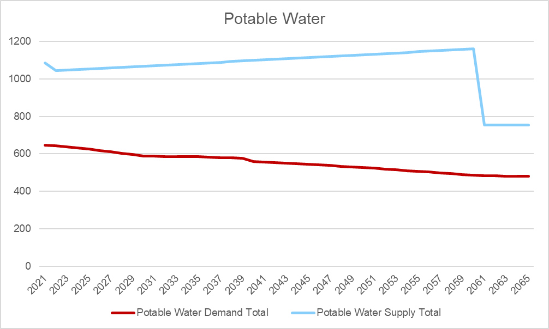
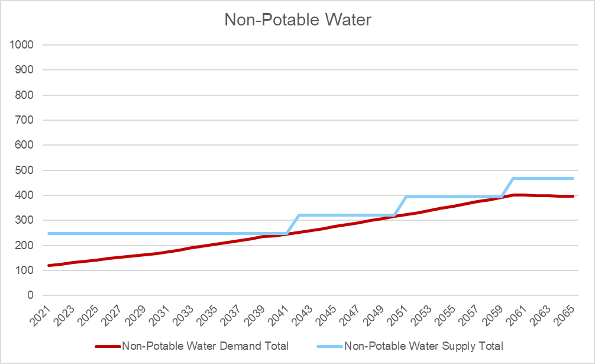
Scenario 2 - Low water demands
Low water demands
Low population projection
High rainfall
High Conservation Effort
High water price hike Agreement ends in 2061
No new desalination plant needed
# New Build NEWater Plant | 3
# Plants | Required by
1 | Build by Year 2042
2 | Build by Year 2051
3 | Build by Year 2060
Potable water demand decreases due to low population (~6m in 2060) and aggressive water conservation

Slide 9
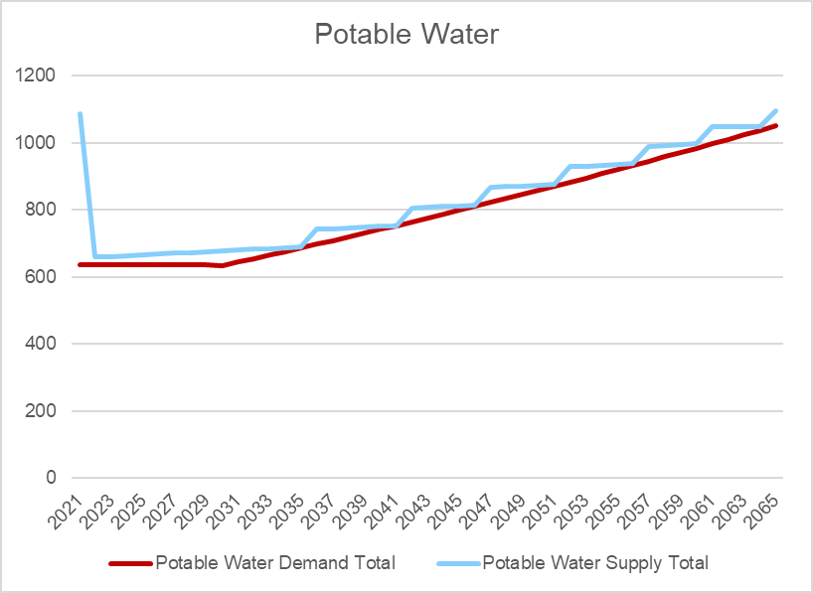
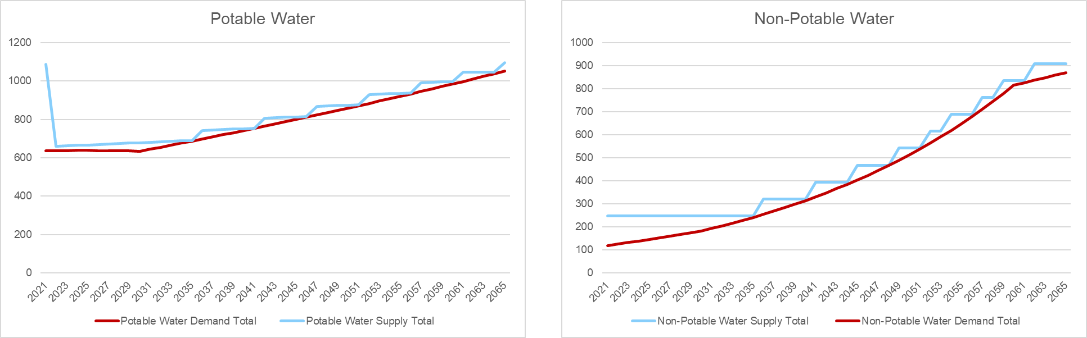
Scenario 3 - High water demands
High water demands
High population projection
Low rainfall
Low Conservation Effort
No water price hike Agreement ends in 2022
# New Build Desalination Plant | 9
# Plants | Required by
1, 2 | Year 2022
3 | Year 2036
4 | Year 2042
5 | Year 2047
6 | Year 2052
7 | Year 2057
8 | Year 2061
9 | Year 2065
# New Build NEWater Plant | 9
# Plants | Required by
1 | Year 2036
2 | Year 2041
3 | Year 2045
4 | Year 2049
5 | Year 2052
6 | Year 2054
7 | Year 2057
8 | Year 2059
9 | Year 2062

Slide 10
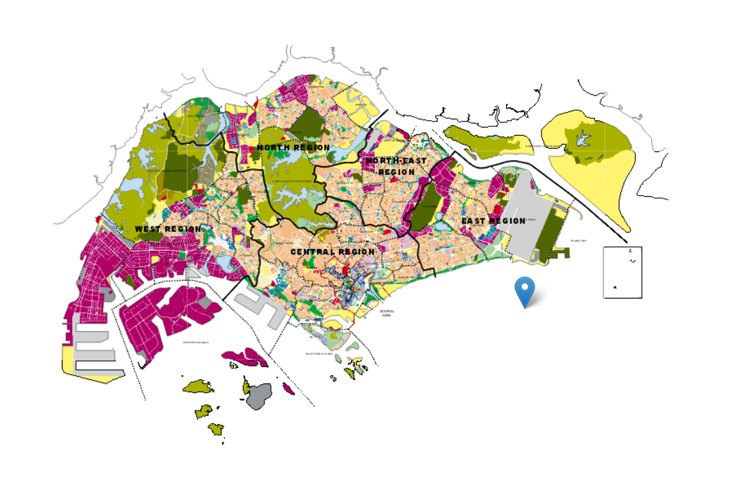
Land constraint estimation
URA Master Planning Map 2022
Average size of NEWater and Desalination plant is ~265,000 m²
19 plants = 5 million m²
Based on URA MP2019, there is *14 million m² set aside for Utilities (including water plants)
^Illustration only
*14 million includes existing facilities and infrastructure

Slide 11



Conclusion
Sensitivity and Trade-Off

Slide 12
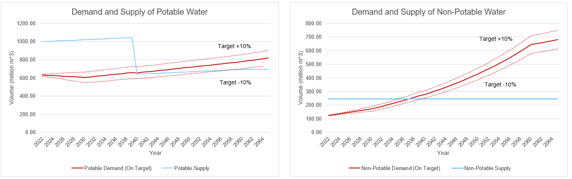
Sensitivity Analysis [1]
Conservation efforts
Based on sensitivity analysis, conservation efforts has the highest impact on demand

Slide 13

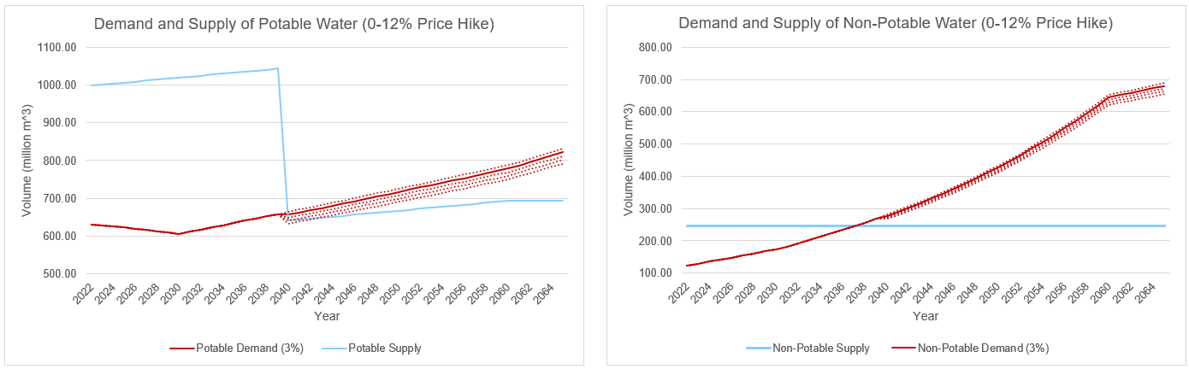
Trade-Off Analysis [2]
Price Hike
A +- 3% price hike will not change the demand much because water is price inelastic

Slide 14

If we all play our part in saving water, only 9 new plants are estimated to be needed
Water conservation efforts is key in reducing demand
Increasing local rainwater catchment is key in increasing supply and achieving self-sustainability

Slide 15
Thank you
Questions and answers

Slide 16
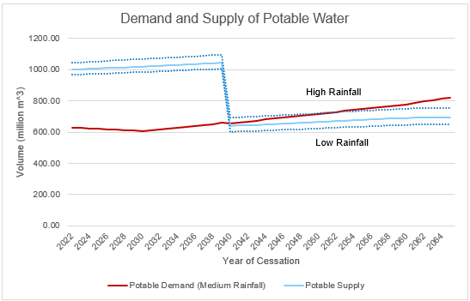
Sensitivity Analysis [3]
Rainfall Intensity
Amount of rainfall has significant impact on water sufficiency in the event of sudden termination of imported water

Slide 17

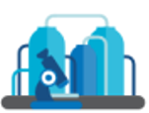

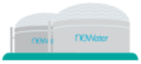
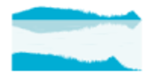
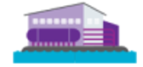



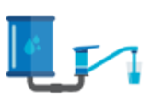
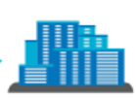
The Water Loop
Rain
Sea
Treatment of used water
NEWater plants
Non-potable
water
Collection of used water
Collection of rainfall in Water Catchment
Desalination plants
Non-domestic Potable Water
Industry
Imported Water
Treatment of raw to potable water
Domestic Potable Water
Households

